Slide 1
Proposal Presentation
Matting based on Bayesian algorithm
Lingyu Gong, Changhong Li, Qiwen Tan
E3 School
Date 15/02/2024

Slide 2
Group Introduction
Members and Roles
Algorithm Engineer – Tan
- Algorithm Research
- Algorithm Function Encapsulation
Reliability Engineer – Gong
- Unit Test
- E2E Test
Integration Engineer – Li
- System Integration
- Code Lint and Review

Slide 3
Presentation
Content
Group Introduction(Tan)
Mathematical Algorithm(Tan)
Function Blocks(Gong)
Testing Plan(Gong)
Flow of Implementation(Li)
Milestones and timeline(Li)

Slide 4
Mathematics
Corner Stone
C: The actual observed color of the pixel.
F: Foreground color.
B: Background color.
α: The probability of the pixel belonging to the foreground, which is the primary value we aim to solve.

Slide 5
Mathematics
Challenge
$F_{R}$
$F_{G}$
$F_{B}$
$C_{R}$
$B_{R}$
$C=αF+\left(1−α\right)B$
Three Equations
$C_{G}$
$B_{R}$
Seven Unknows
$C_{B}$
$B_{R}$
How do we solve seven unknowns with three equations?

Slide 6
Mathematics
Maximum Likelihood
User input / Trimap
⬇️
F and B value estimation
⬇️
α value estimation
One iteration

Slide 7
Mathematics
Maximum A Posteriori
$arg\max_{α,F,B}P\left(α,F,B | C\right)=arg\max_{α,F,B}\frac{P\left(C∨α,F,B\right)P\left(α,F,B\right)}{P\left(C\right)}$
Log Likelihood
$L\left(α,F,B | C\right)=arg\max_{α,F,B}L\left(C∨α,F,B\right)+L\left(F\right)+L\left(B\right)+L\left(α\right)$
Constant(omitted)
Let’s solve each terms one by one

Slide 8
Mathematics
$argmaxL\left(C | α,F,B\right)$
Recall C=αF+(1-α)B
⬇️
Minimize the difference between C and
⬇️
(where is the standard deviation )

Slide 9
Mathematics
$L\left(F\right)$
Weighted Covariance Matrix: Distance

Slide 10
Mathematics
$L\left(B\right)$
Similarly, we have

Slide 11
Mathematics
Log Likelihood
$L\left(α,F,B | C\right)=arg\max_{α,F,B}L\left(C∨α,F,B\right)+L\left(F\right)+L\left(B\right)$
$−\frac{∨C−αF−\left(1−α\right)B∨{}^{2}}{σ_{C}^{2}}$
$−$
$−$

Slide 12
Mathematics
Iteration
Treatas a constant and find partial derivatives of F and B
⬇️
⬇️
Treat F and B as constants and find partial derivative of
⬇️

Slide 13
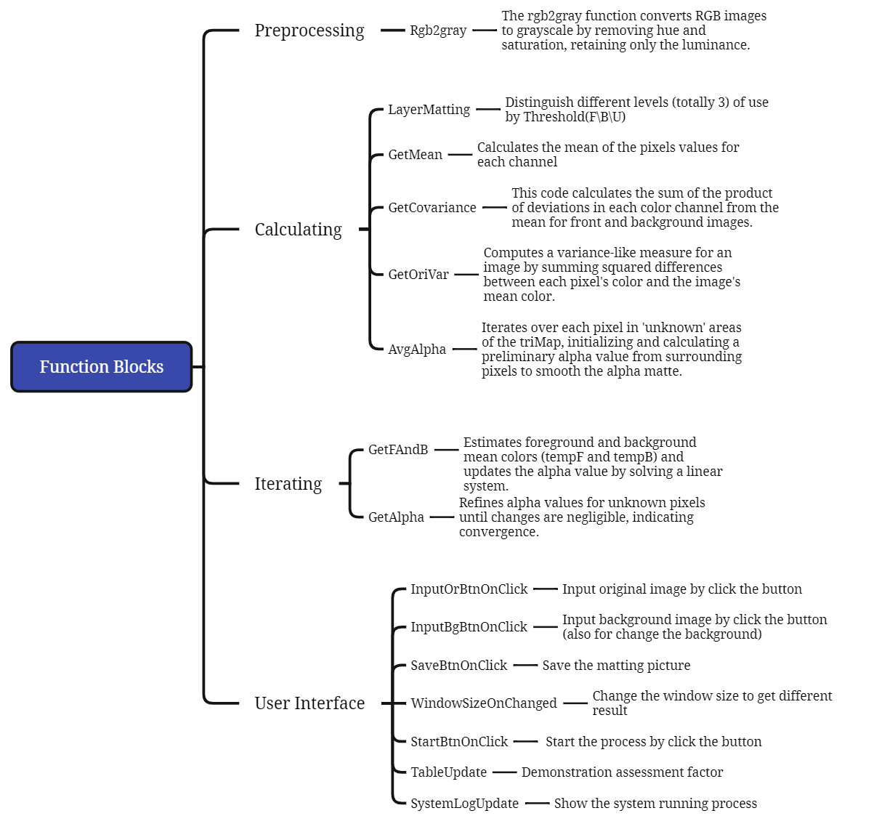
Function Blocks
Preprocessing
Simplification: Efficiency, Streamlining, Single Intensity.
Threshold Consistency: Predefined Thresholds, Intensity Classification.
Standard Matting Practice: Image Matting, Grayscale Guide.
Compatibility with Logic: Processing Consistency, Intensity-based Logic.

Slide 14
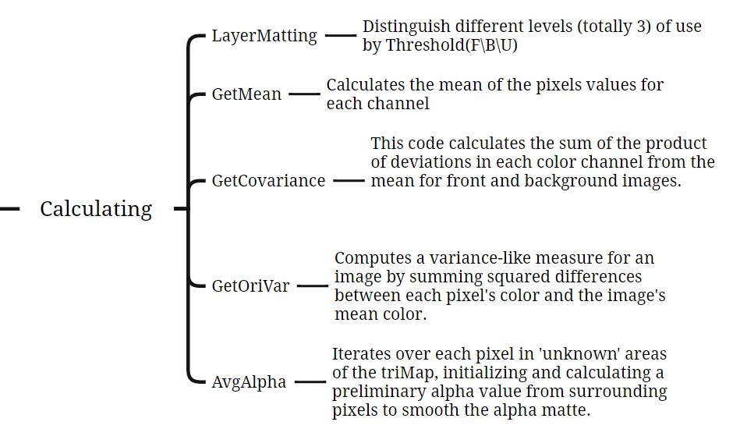
Function Blocks
Calculating
The calculations provide key color insights for distinguishing the foreground from the background, crucial for areas with unclear boundaries like hair or fur.
Mean Calculation: Color Averaging, RGB Channels, Region Centrality
Covariance Matrix: Color Variation, Channel Relationship, Texture Analysis
Normalization: Scale Adjustment, Pixel Count Relevance, Average Representation
Variance Calculation: Noise Estimation, Texture Characterization, Color Deviation Measurement

Slide 15
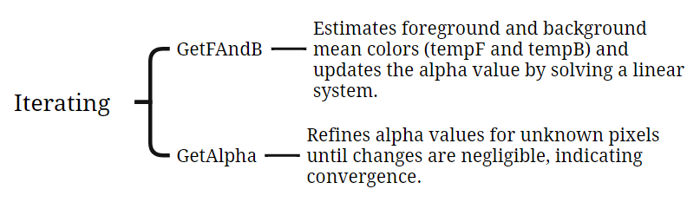
Function Blocks
Iterating
This part will refine the alpha matte in complex image areas (such as edges, hair, fur) by iteratively adjusting transparency and color for precise foreground-background separation.
Alpha Matte Refinement: Precise Transparency Adjustment
Complex Area Focus: Edge, Hair, Fur Detailing
Iterative Calculations: Repeated Fine-Tuning
Foreground-Background Separation: Accurate Color Segregation
Transparency Calculation: Alpha Value Determination
Color Matching: Foreground-Background Color Alignment
Convergence Check: Optimal Alpha Value Assessment

Slide 16
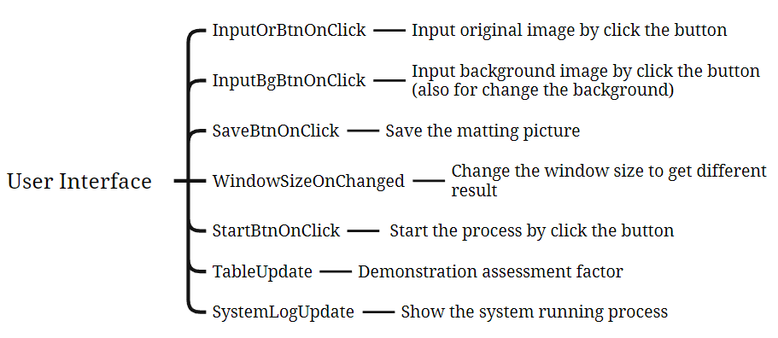
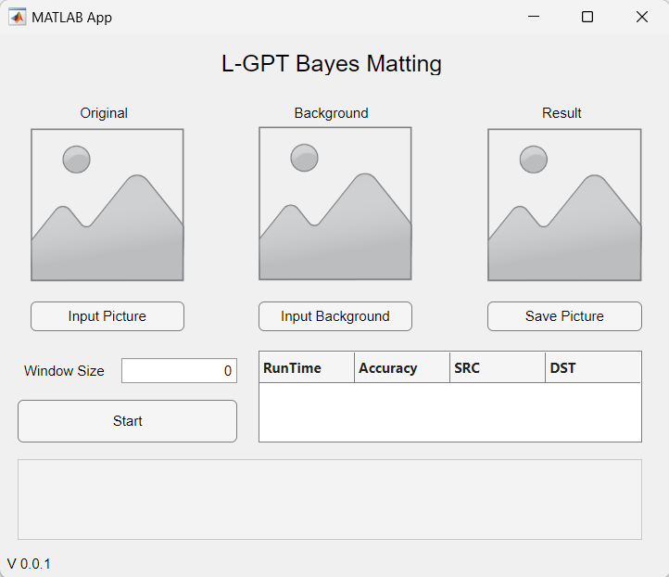
Function Blocks
User Interface
Data visualization capabilities
Easy integration with MATLAB's computational functions
User-friendly interface for creating and customizing GUIs without needing extensive programming skills.

Slide 17
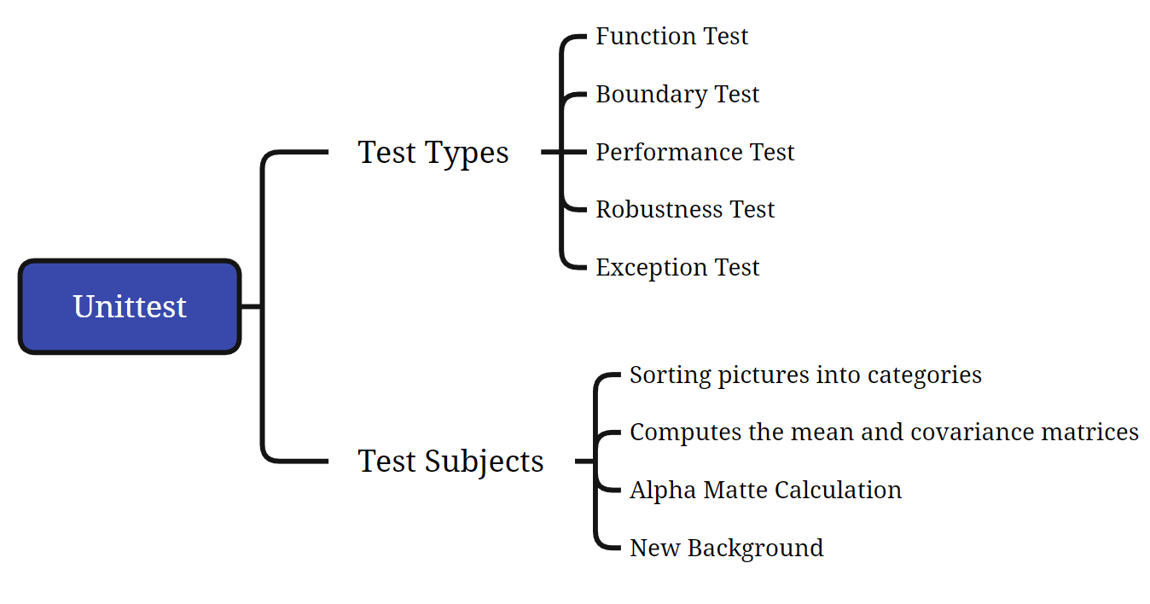
Unittest

Slide 18
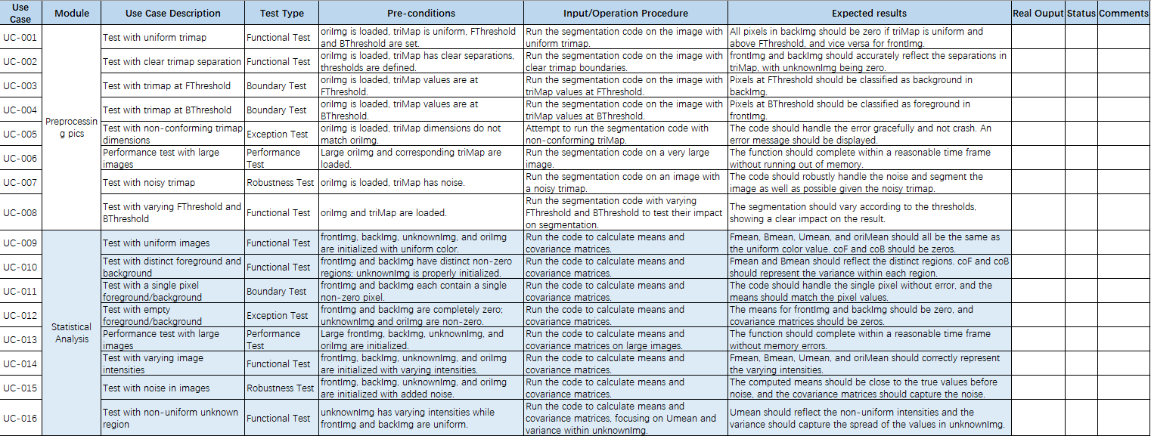
Unittest

Slide 19
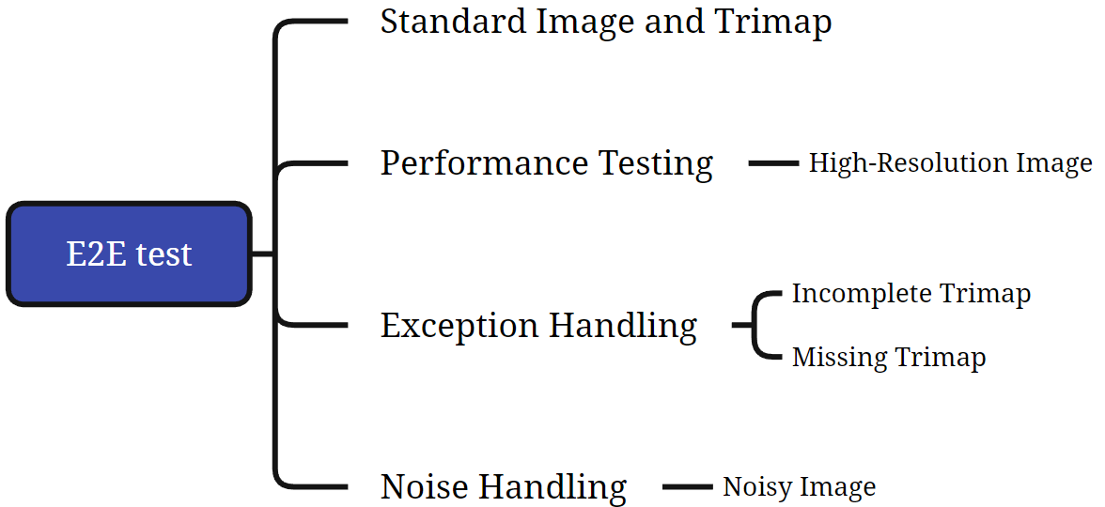
E2E test

Slide 20
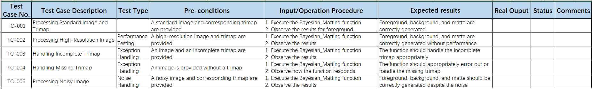
E2E test

Slide 21
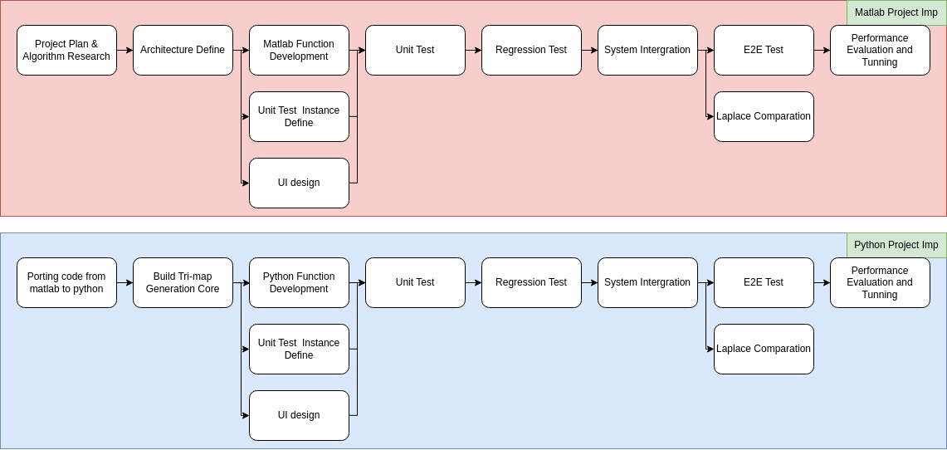
Flow of Implementation
Implementation of whole project

Slide 22
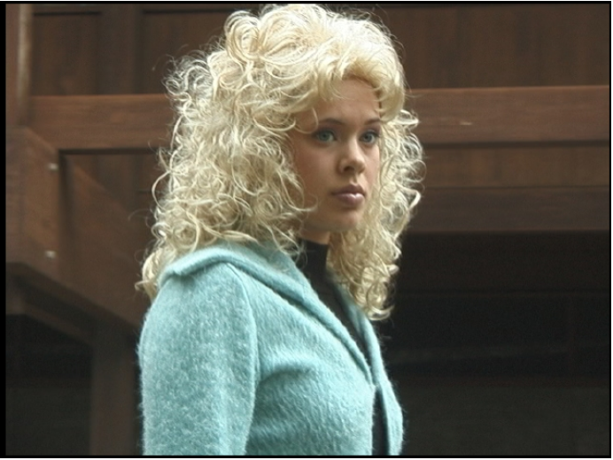

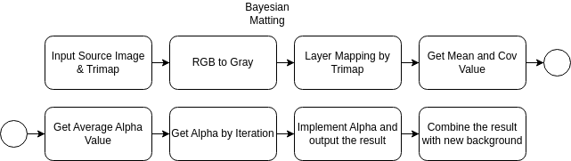

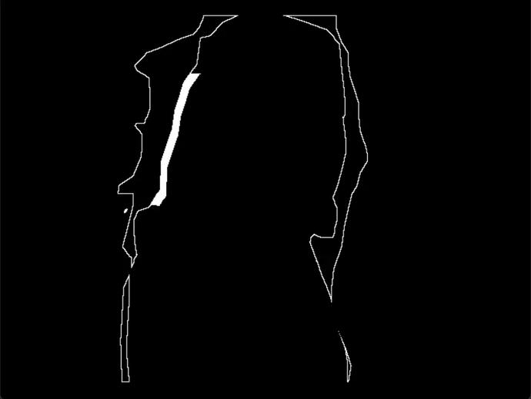
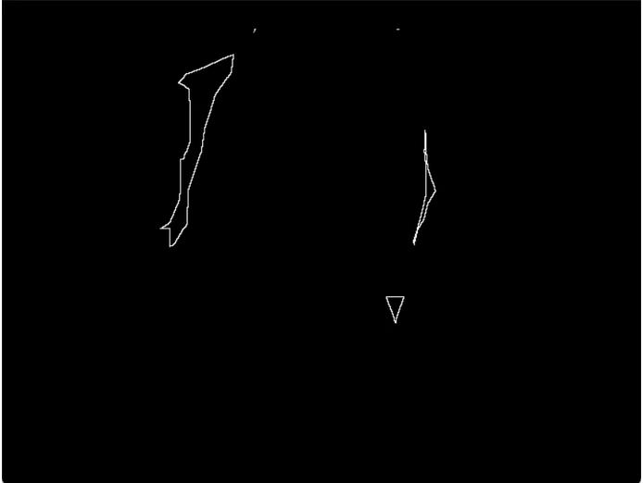
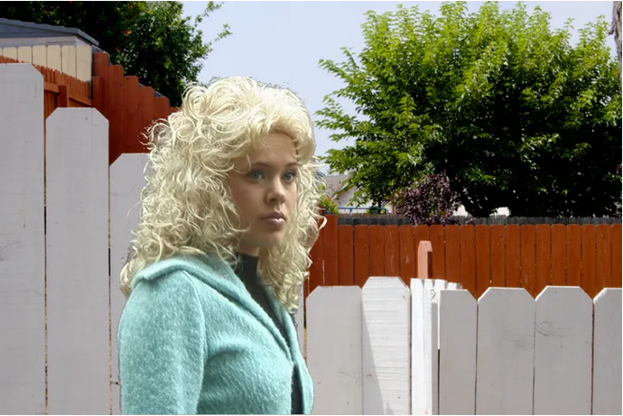
Flow of Implementation
Core Algorithm Implementation

Slide 23
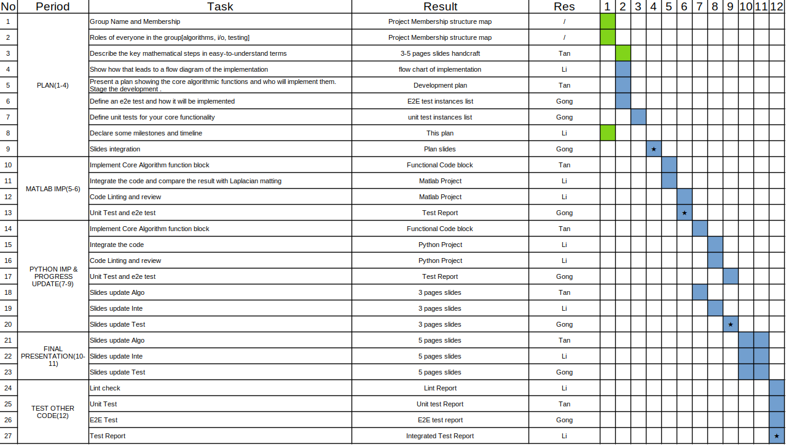
Milestones and timeline

Slide 24
Thank You

